Slide 1
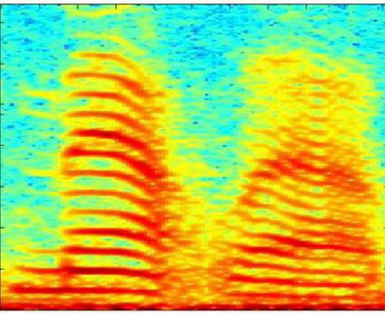
CNN Structure on STFT Spectrogram
STFT Spectrogram 분석을 위한 CNN 구조
Convolutional layer와 max-pooling layer를 순차적으로 적용
Feature Extraction
NG : 81%
OK : 19%
Classification

Slide 2
Channel : 32
Channel : 32
Convolution
3x3
Pooling
2x2
Convolution
3x3
Pooling
2x2
Convolution Layer
Fully connected layer

Slide 3
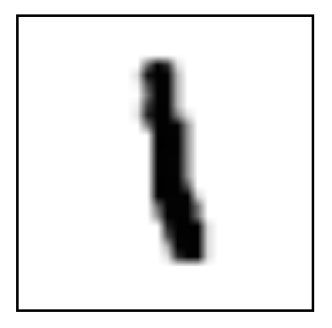
Channels
32
Channels
32
Channels
64
Channels
64
Input
28x28
Convolution
3x3
Pooling
2x2
Convolution
3x3
Pooling
2x2
Convolution Layer
Fully connected layer

